Slide 1
Duck TAPE
Group 6: Noah Haney, Austin Enloe, Trent Dufour

Slide 2
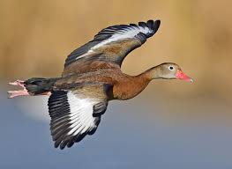
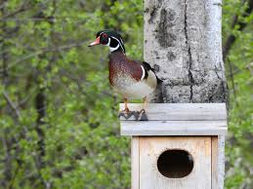
What is the purpose?
The purpose of Duck Tape is to dwindle down on any black belly ducks intervening with any wood duck’s nest
The black belly ducks are laying eggs in the wood ducks nest and are leaving them for wood duck’s to raise. The problem with this is that the wood ducklings are no longer getting the same amount of care that they would usually require due to the extra duckling.
Black Belly Duck
Wood Duck

Slide 3
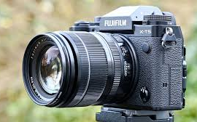
What it is:
Duck Tape is a motion sensored camera that takes pictures in a wood duck nest.
Those pictures are then sent to an A.I. (Gemini) that will identify said picture.
Any pictures that are recognized as a black belly duck are then posted on the GUI for the user to look at
Notes:
Austin

Slide 4
Demonstration : Core Features
A Esp32 hardcoded to detect motion through difference in frames captured
Code that communicates with Gemini to identify pictures
A Database that stores and pulls images
A FTP Server which transfer pictures from the camera to the raspberry pi
A GUI with a posted date and time of which the picture was captured
Notes:
Noah

Slide 5
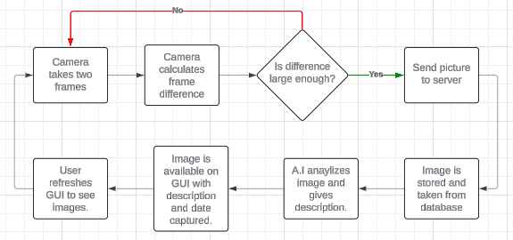
Demonstration : Loops
For the code to run both the A.I., camera, and file manipulation script have to be in a infinite While loop
In order to limit the amount of pictures sent to the server, delays occur to prevent from overwhelming the server or A.I.
Notes:
Austin

Slide 6
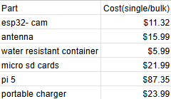
Tools : Hardware
Esp 32 Camera attached with a motion sensor
Raspberry Pi 5 with LED display
Battery pack for wireless capability
Along with an antenna and waterproof casing
Bill of Materials
Notes:
Austin

Slide 7
Tools : Software
Google Gemini - AI used through API service
Pygame - GUI Library
mariadb/mysql - SQL Database
Pure-ftpd - FTP server
Notes:
Noah

Slide 8
Future Developments
Have the Esp connect to the FTP server and the database via the cloud so we can design a cloud based web server to access everything.
Convert our GUI into a app.
Utilize JSON style responses for boolean checks by A.I. for example(there is a wood duck in this picture: TRUE).
This could also be universal towards any user for daily household use. For example(the mail man dropped off a package, or there is a raccoon in your trash).
Lastly to re-work discord bot for unique alert options for Example: i'm going out of town this weekend can you alert me if a package gets delivered.
Figuring out a better way for motion detection.

